Slide 1
Heterogenous Swarming and Formations of BOLT and RVR
Nicholas Liu z5364371

Slide 2
Problem Statement
Aim:
To achieve emergent formations within heterogeneous swarms of RVR and BOLT robots
Significance:
Research into formations of heterogeneous swarms lags that of homogeneous swarms
Heterogeneous swarms have shown significant promise in real – world applications
Notes:
The aim is of this research project is to achieve emergent formations within heterogeneous swarms of RVR and BOLT robots
Why is this significant?
Heterogeneous robotics swarms present an opportunity for robotics swarms to utilise different types of robots to further extend the problem set that they can solve
Emergent behaviour within robotics swarms is desired as it emulates the result of natural evolution in animal swarms and is more robust and flexible then controlled formations

Slide 3
Literature Review
Boid Model and Swarm Formations
Rules based between agents
Applications of Heterogeneous Swarms
Search and rescue
Environmental monitoring
Autonomous exploration
Benefits of Heterogeneous Swarms
Scalable
Robust
Flexible
Capable
Models natural swarm intelligence
Notes:
The literature review focused on 3 different topics as shown here, within these the following critical information was found:
The Boid Model and Swarm Formations: Craig Reynolds' Boid model (1986) introduced the concept of simple agents (boids) following three rules: separation, alignment, and cohesion to simulate flocking behaviour for computer graphics.
The model was then implemented in the field of swarm robotics. There is significant research in the space of formation control but limited research into emergent formations within swarms, these differ to formation control,
Formation control uses graphical/RL/rules based techniques to create strict formations, emergent formations are developed naturally through modification of Boid parameters.
Key Applications: Heterogeneous swarms have been used in areas such as search and rescue operations, environmental monitoring, and autonomous exploration; essentially they are commonly seen implemented in communications and GPS denied environments.
Benefits of Heterogeneous Swarms: These swarms can perform complex tasks more efficiently by leveraging the unique strengths of different robots, this means that not only do they exhibit the three key features of robotics swarms in that they are, scalable, robust and flexible.
Heterogeneous swarms are also capable, as they can mix and match different capabilities within the swarm.

Slide 4
Literature Review
Identified gaps in knowledge:
Limited implementation of heterogeneous swarms using commercially available robots
Formations in heterogeneous swarms are created using a top – down ‘control’ strategy vs. emergent collective behaviour
Notes:
Limited implementation of heterogeneous swarms using commercially available robots
Most research papers utilise eye, hand and foot robots that were first designed in “Swarmanoid”
Formations in heterogeneous swarms are created using a top – down ‘control’ strategy vs. emergent collective behaviour (ref Abpeikar et al., Khan et al.)
By implementing heterogeneous swarming in BOLT and RVR robots this paves the way for further research and implementation of simulated data sets, with formations providing an examples of this

Slide 5

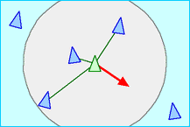
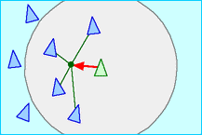
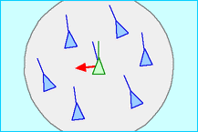
Boid Swarming
Agent’s move based on rules:
Separation
Avoid neighbours to prevent collision
Cohesion
Move towards average position of neighbours
Alignment
Move in average heading of neighbours
Notes:
Boid swarming is defined by its nature:
Agents move based on the positioning and velocity of their neighbours, this can be described in three rules
Click
Separation
Click
Cohesion
Click
Alignment
Each rule has its own parameters with a weight to determine how strong that particular rule force is and radius to determine the distance at which a neighbour will be included for the calculation of force

Slide 6
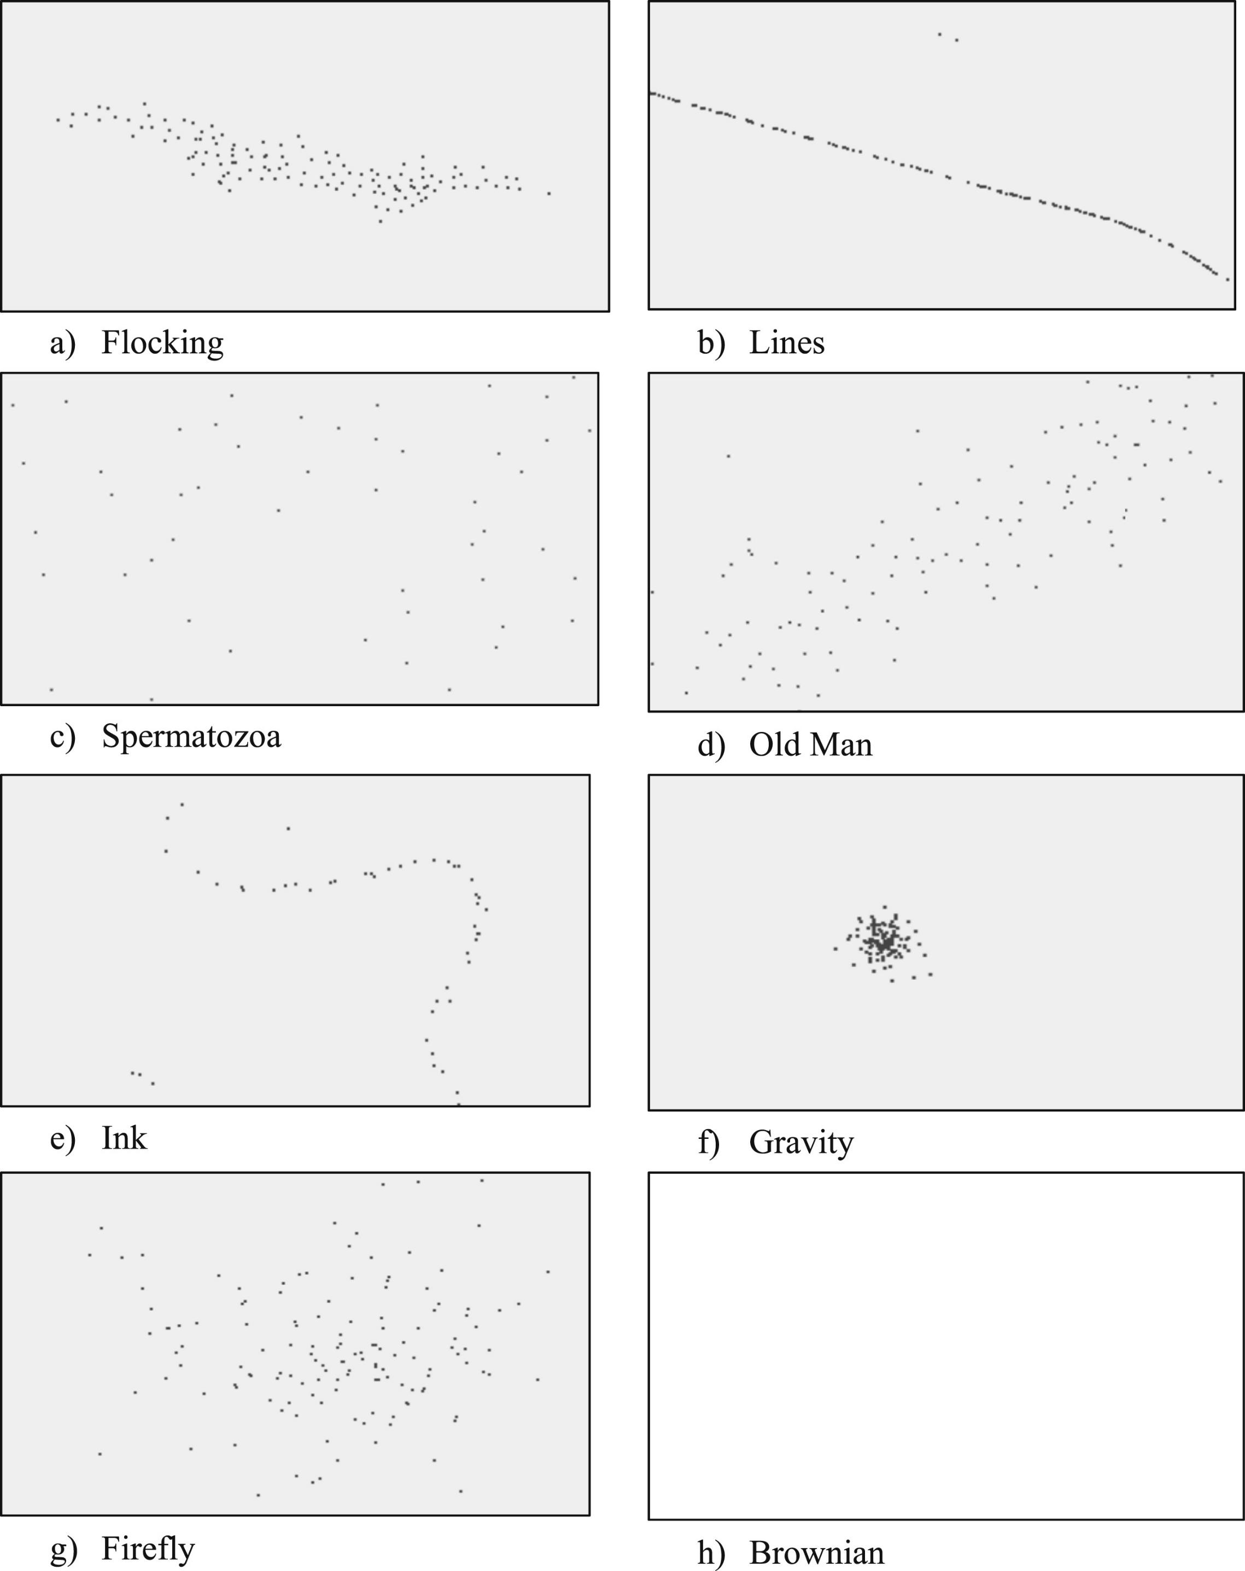
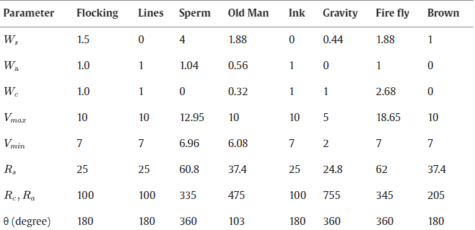
Emergent Behaviour
Exists in nature through evolutionary drive (e.g. : birds flocking, ants in a line)
Modifying Boid parameters to recreate this within artificial swarms
Notes:
Emergent collective motion and emergent formations have been shown in existing research (Khan et al. and Abpeikar et al.) through modification to the Boid parameters
This can be seen within the slide, as the parameters match up to the different simulated emergent behaviour
The goal of this research project is to utilise this work and to modify and implement this within the heterogeneous swarm
This is made possible by provision of swarming code for both BOLT and RVR

Slide 7
Current Progress
RVR and BOLT Communications
Simulations with size and agility heterogeneity
Heterogeneous Boid Swarming with Vicon Code
Notes:
The current progress revolves around the main plan:
There are two key parts of this research project:
The swarming code and the emergent formations
For the emergent formations Boid swarming code must exist, for the swarming code, communication between RVR and BOLT must work
Simulations provide additional support to the development of emergent formations
Hence this is why current progress has been dedicated to these 3 areas

Slide 8
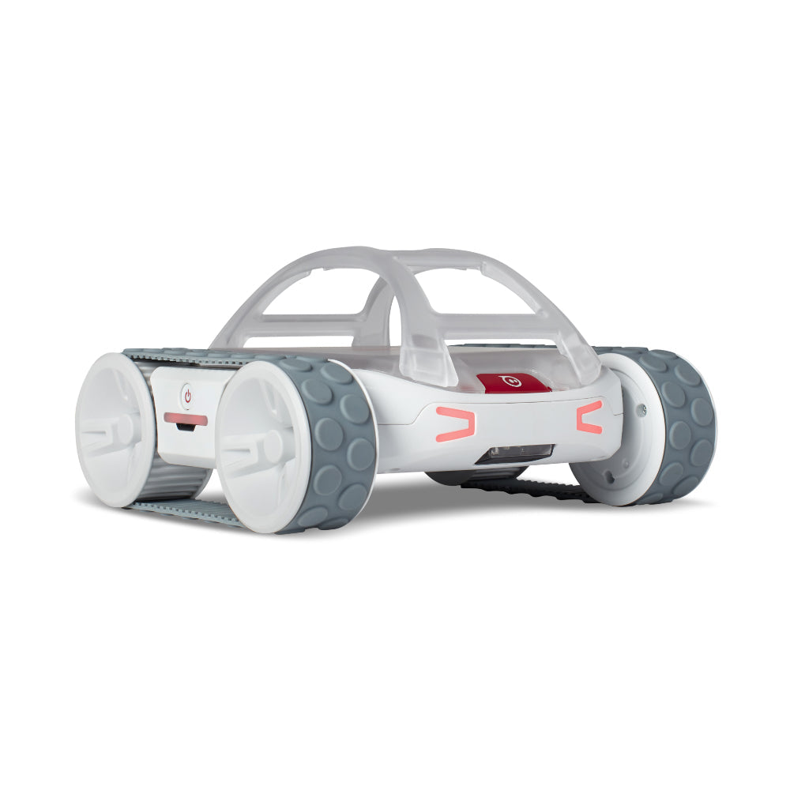
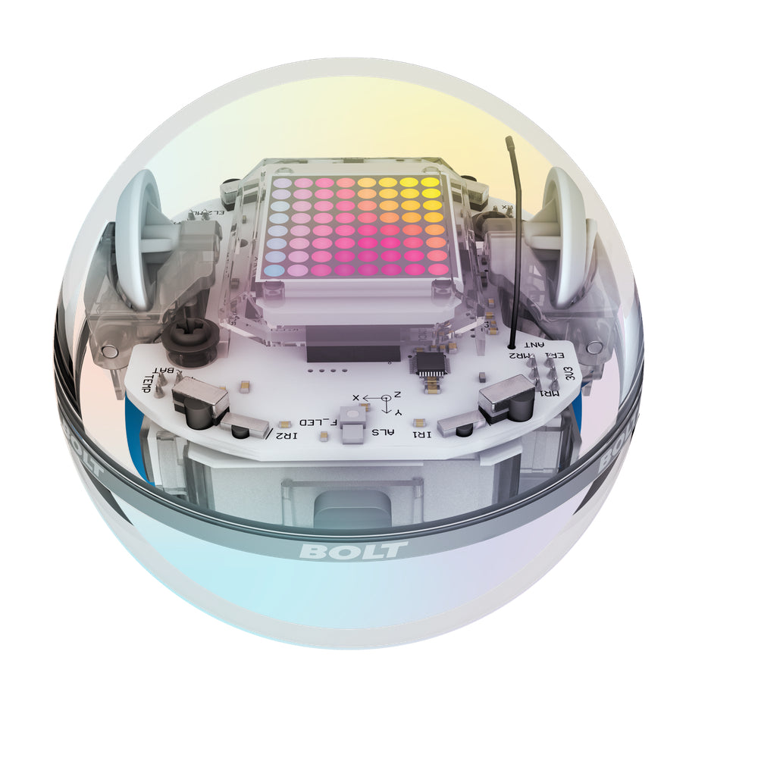
RVR and BOLT Similarities
Accelerometer
Gyroscope
Magnetometer
Light Sensor
Encoders
Notes:
The sphero RVR and BOLT robots are very similar, being made by the same company, functionally they share almost identical sensors and motor controllers, however there are some key differences

Slide 9
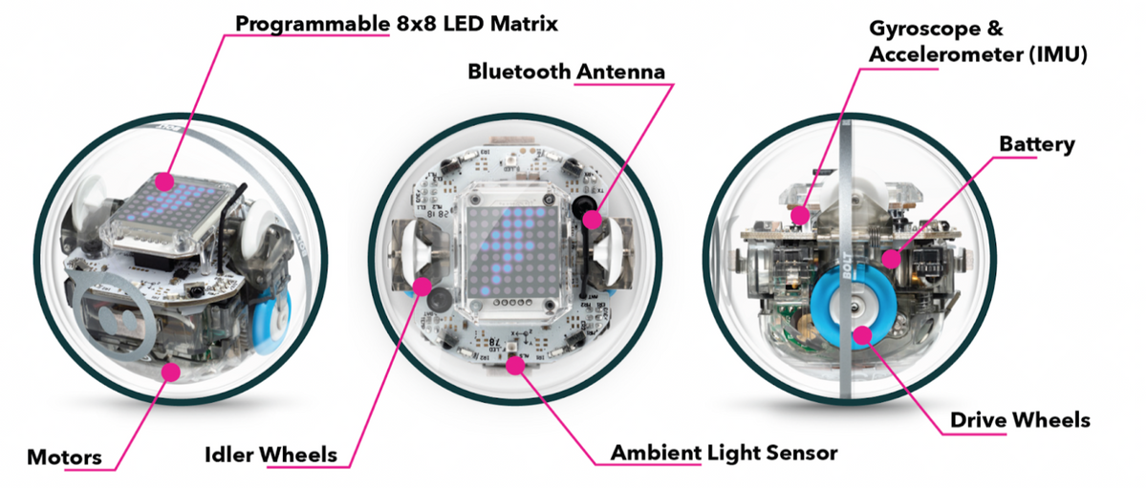
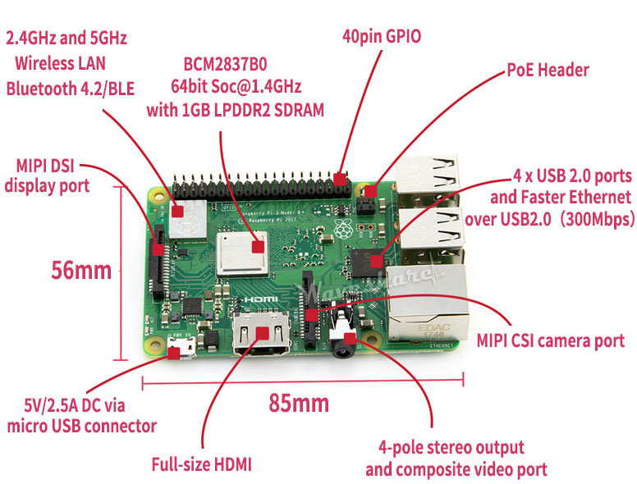
RVR and BOLT Differences
RVR - Raspberry Pi 3B via UART
GPIO Expansion Pins
Bluetooth 4.2
USB 2.0
WiFi
BOLT - Onboard microcontroller
Bluetooth 4+
IR Transceiver
Notes:
The key differences aside from side, reside in their communications and software abilities, the BOLT is mostly designed to be a product that comes “as – is”, while the RVR is designed to be expandable

Slide 10
Communications
Infrared
Bluetooth
Line of Sight
Can transmit distance and data
Existing implementation of BOLT IR following of RVR
Python implementation cannot adjust following or send complex custom messages
RF communication
BOLT given commands through spheroV2 API via Python
Processing can be performed on Raspberry Pi 3B+
Notes:
Communications were chosen based on the differences between the RVR and BOLT communications schemes
There is first the inbuilt IR communications as well as communications utilizing the Bluetooth available onboard the Raspberry Pi 3B+
IR is more processing happening onboard the BOLT and the BOLT could be initialized as it’s own robot while Bluetooth would require the BOLT to essentially be remote controlled by the Raspberry Pi on the RVR
Click the slide so it clicks over to the animation
So… why was Bluetooth chosen?
Infrared looked promising at first due to the existing IR following implementation, after further investigation this feature was locked down and could not be modified
Therefore, Bluetooth is the only logical solution on how the RVR and BOLT will talk to each other

Slide 11
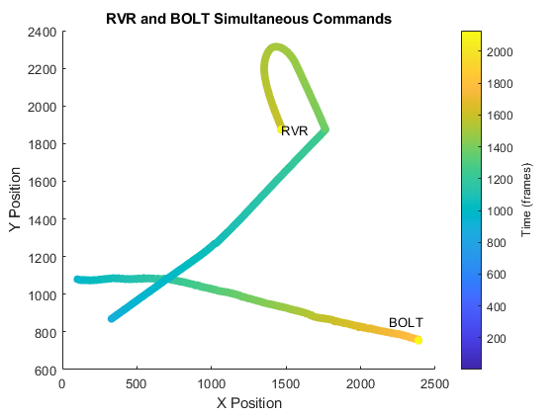
Communications - Proof of Concept
Built off existing RVR code
Code ran:
RVR moving and turning sporadically
BOLT moving in straight line while slowly updating its heading
Notes:
This shows an experiment with both robots running of the raspberry Pi simultaneously
As can be seen both robots start at the same time, move at the same time, and stop at the same time (within reason)

Slide 12
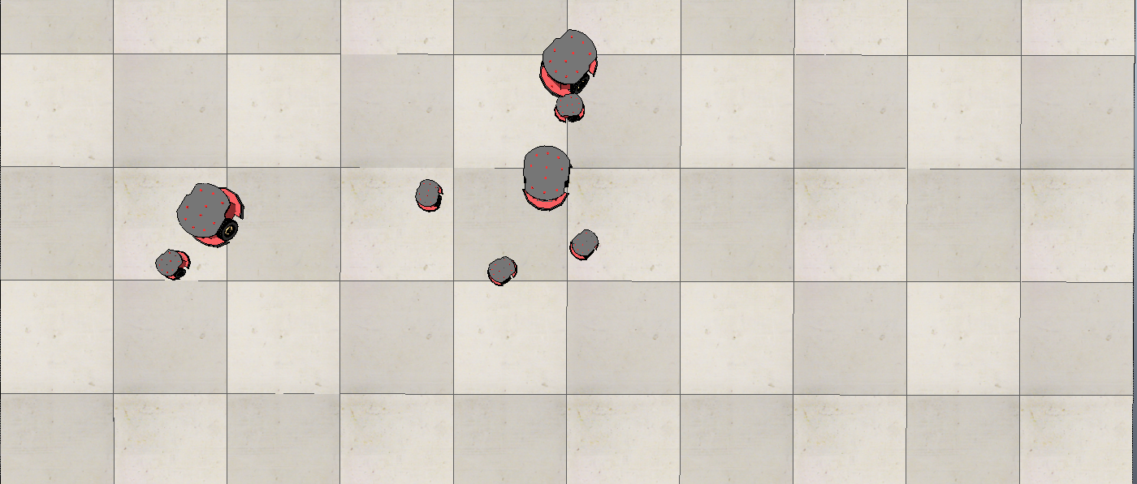
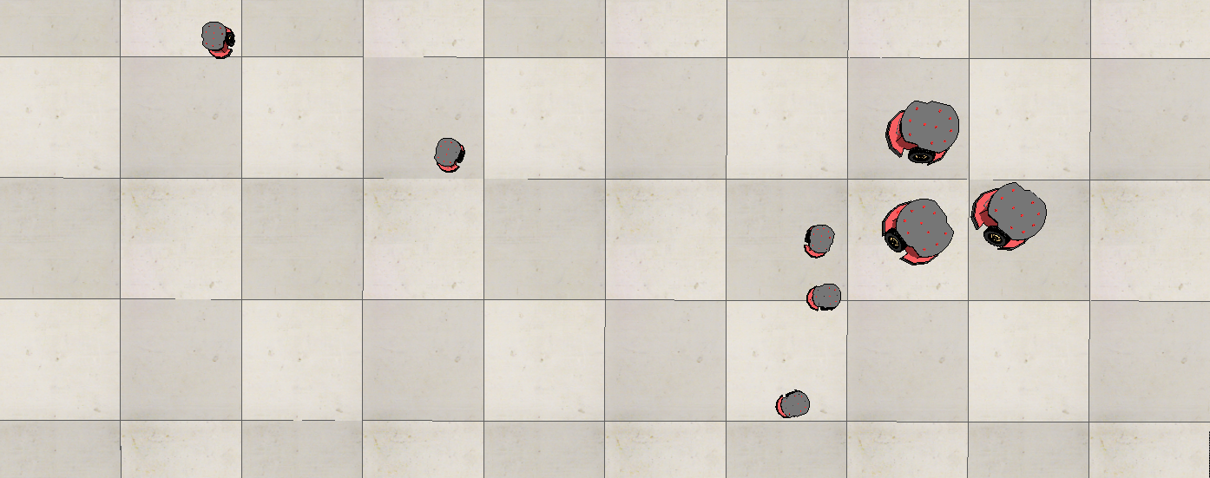
Simulations
Unexpected Collisions
Swarm Divergence
Notes:
During the simulation, after agents had initially formed swarms, two key issues were noticed, collisions and divergence
This is most likely due to the lack of scaling of swarm velocity as well as the lack of different boid rule radii
The simulations proved useful in uncovering possible challenges that may come about in the development and implementation of the full code
The overall takeaway from the initial simulations were that faster robots and slower robots need to have adjusted boid parameters or artificial linear and angular velocity limits

Slide 13
Current Code
Vicon Bridge
Python Vicon DataStream SDK is Windows only, no existing ARM compiled version
Vicon bridge transmits vicon data from Windows via pylsl to Raspberry Pi
Modified to transmit robot identifiers and BOLT location data to Raspberry Pi
Vicon Locator
Pulls pylsl stream from Vicon Bridge run on laptop and passes data to RVR and BOLT Agent objects
Notes:
Vicon exists to act as a local positioning system so robots can identify their own locations with high levels of accuracy
The Vicon DataStream SDK is Windows only and thus the vicon bridge between Windows machine and Raspberry Pi exists
The data is transmitted over LAN using pylsl streams
The original Vicon bridge has been modified to transmit both the BOLT location data and identifiers for each robot,
Currently the vicon bridge will transmit the BOLT location and identifier to the IP address of the last RVR within its internal list,
This means that for multiple RVRs and BOLTs the swarms will have to be manually configured with

Slide 14
Current Code
Agents
Boid agent object with knowledge of its own and its neighbours’ position and velocity
1st iteration utilised RVR and BOLT specific methods
Conflicts with RVR asyncio library
2nd iteration utilises RVRAgent and BOLTAgent specific objects
RVR Controller
Initialise the Vicon Connection, RVR and BOLTs,
Pass location data locally on the Raspberry Pi
Transmit local data over TDP LAN to other Raspberry Pi’s
Notes:
The conceptual design of the code is to initialise each robot as a Boid agent under its own thread
To enable parallel computing
To enable raspberry Pi to host multiple BOLTs as well as its own RVR
To enable raspberry Pi to transmit its BOLT and RVR data to other Raspberry Pi
1st iteration –
RVR and BOLTs were ran through specific methods under the Agent class
This caused issue with RVR control system that utilised an asyncio control loop while the BOLT spheroV2 library did not use this
2nd iteration –
RVR and BOLT specific classes,
This has shown specific advantages in controlling the RVR and BOLT, resolving runtime issues and increasing modularity of the system
Vicon data is now handled outside of the Agent class in its own ViconLocator.py class.
The disadvantage of this is now objects must pass data between each other, which presents a software development and compute power challenge
Currently the data is passed through each object on the Raspberry Pi through a .json file - > faster then a csv file while maintaining python dictionaries of locations
RVR controller is the code that runs on the Raspberry Pi and effectively controls both RVR and BOLT agent objects as well as controlling Vicon data and overall data flow

Slide 15
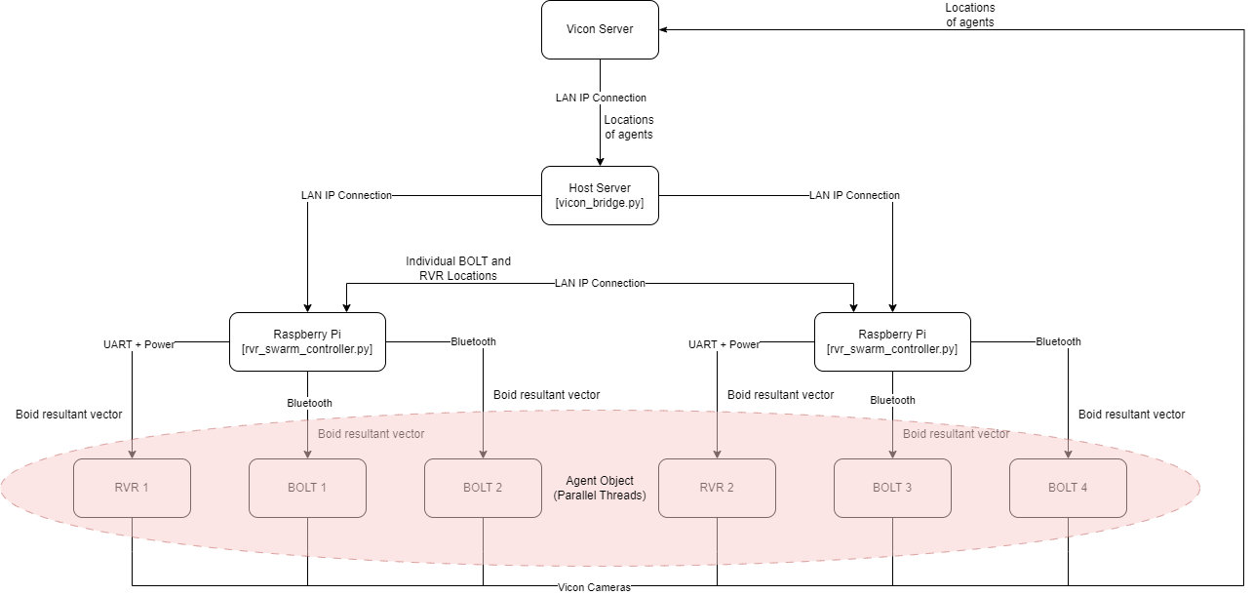
Notes:
This diagram shows both the communications scheme as well as the architecture of the entire system
This is the earlier version
The current version has different objects and vicon data is now handled within the raspberry pi top level code and not through the agent objects as well as the agent objects being separated into specific RVR and BOLT objects
Further testing will be done to fully determine how many BOLTs can run off one raspberry Pi

Slide 16
Future Work
Notes:
The key timings are the milestones as shown,:
Most importantly, currently:
Tracking well with communications, it works
Tracking slightly behind on forming the first successful RVR and BOLT swarm as there was a design decision made to rewrite the code base
The simulation side of the project will evolve as it is developed, and may require significantly more or less time than predicted to produce emergent behaviours within the swarm

Slide 17
Future Work
Swarming Code
Development and Validation
Testing and Optimisation
Formations
Applying previous work to the project
May require further simulations
Extension: Asymmetric Behaviour
Can optimised asymmetric behaviour emerge and be implemented?
Notes:
The future is to develop and validate the swarming code as well as recurrent testing and optimisations
Once the swarming code is running the formations can begin to be applied from the previous mentioned research paper to the project and this will come with its own challenges
If there is time, a possible extensions would be to identify in simulations and implement asymmetric emergent behaviours

Slide 18
Conclusion

